Slide 1
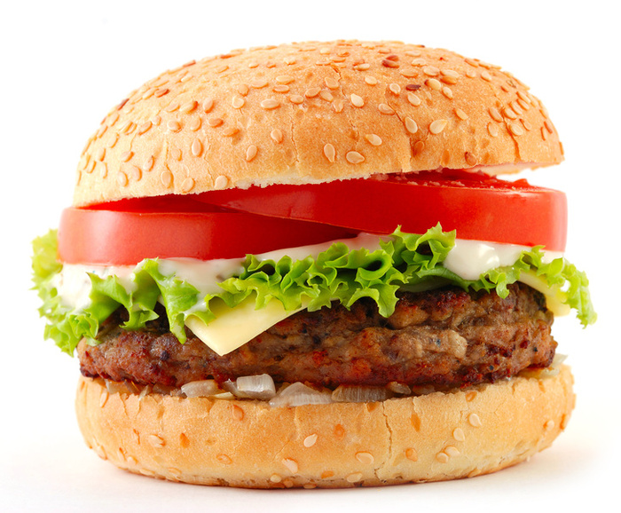
Weight Stigma and Training for a Weight Inclusive Health Care System
Nutrition Leadership Network conference
March 30th, 2022
A. Janet Tomiyama, Ph.D.
Associate Professor
Department of Psychology, UCLA

Slide 2
I have no conflicts of interest or disclosures to report.

Slide 3
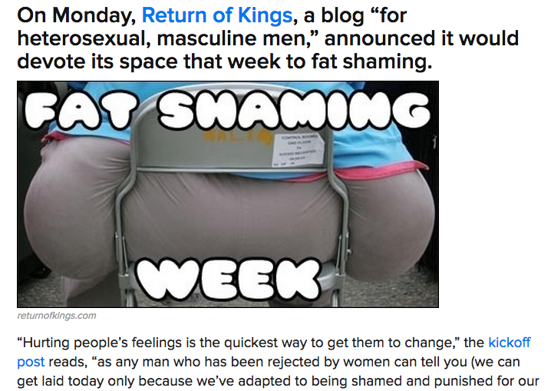

Slide 4
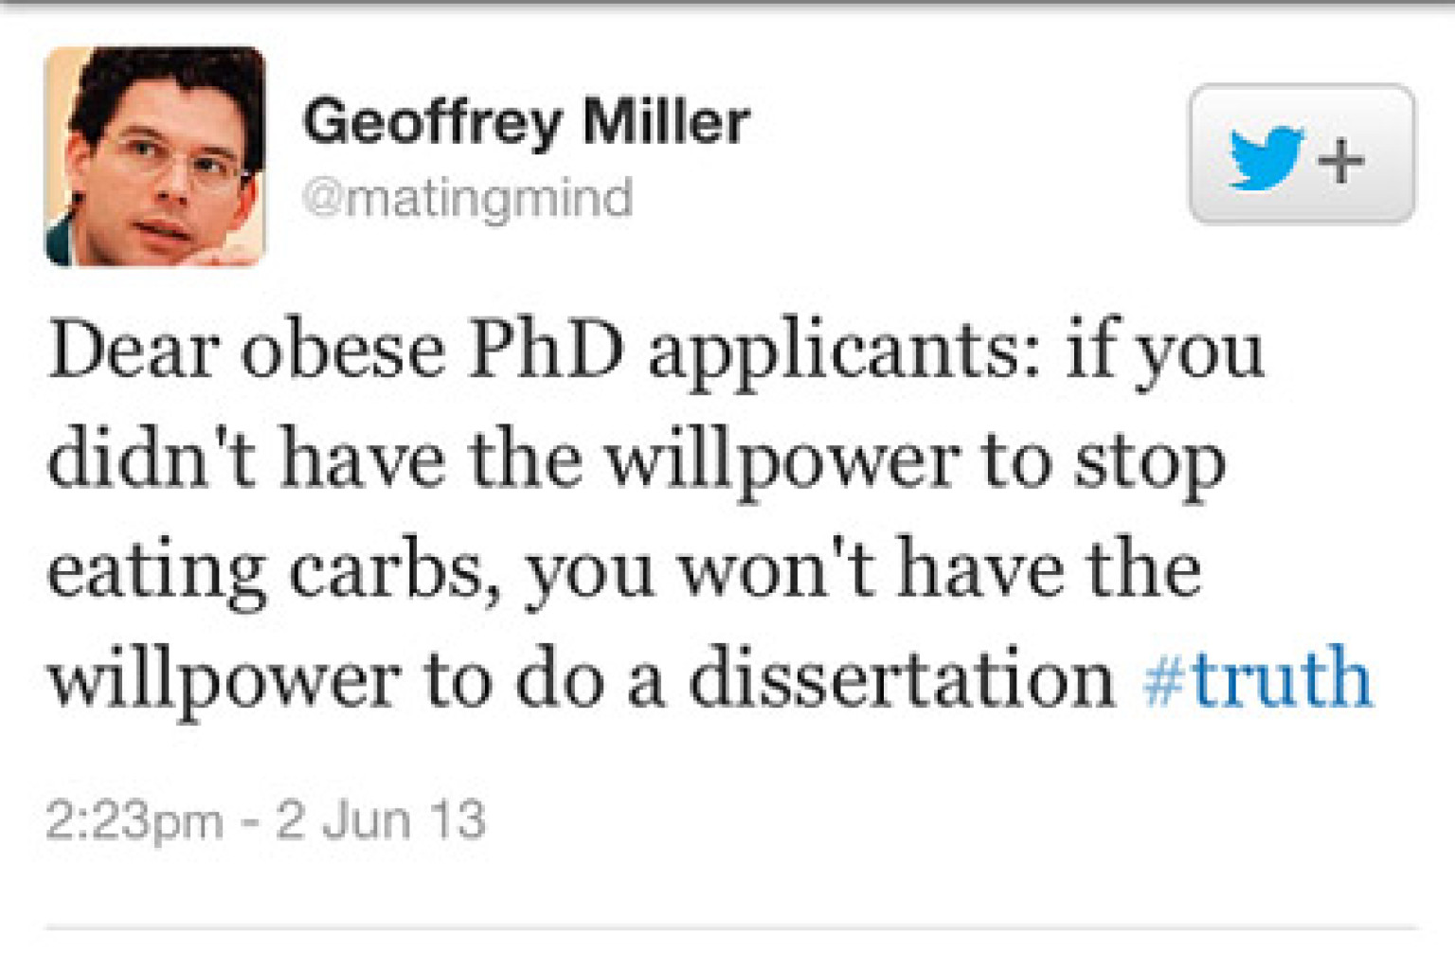
Conclusions from Lab Studies of Eating, Part I
Consumption After a High-Fat Preload
Psychology of Eating
Even from one of our own

Slide 5
Conclusions from Lab Studies of Eating, Part I
Consumption After a High-Fat Preload
Psychology of Eating
What examples have you noticed?
Please put brief descriptions in the chat

Slide 6
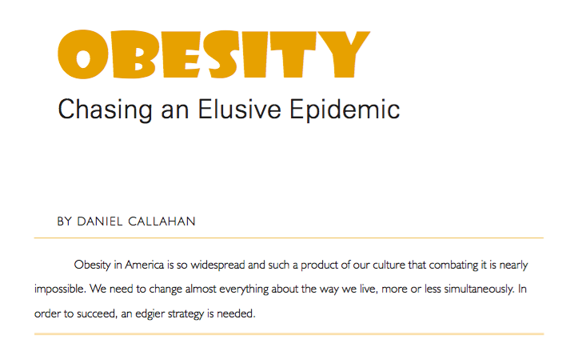
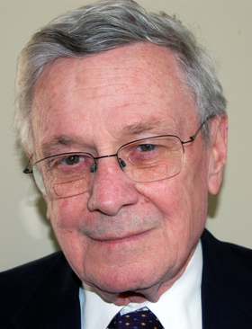
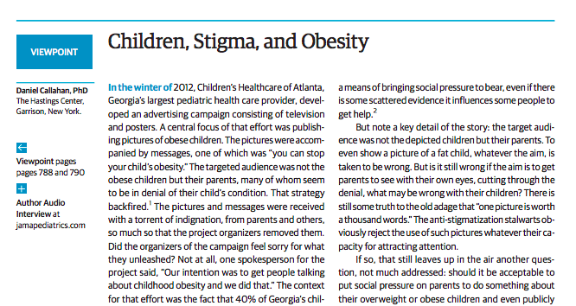

Slide 7
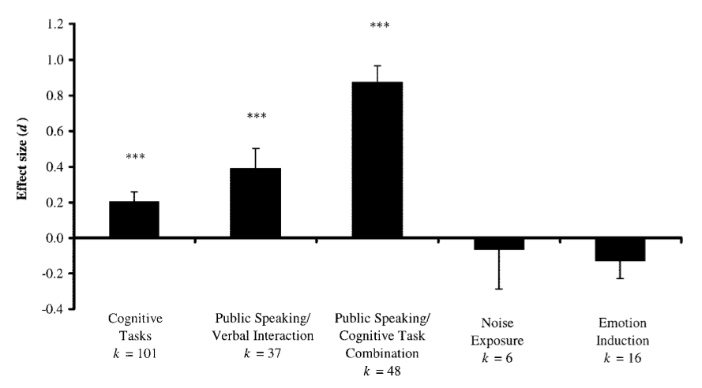
Stressors that are (a) social and (b) evaluative elicit the most cortisol
(Dickerson & Kemeny, 2004, Psychological Bulletin)

Slide 8
Cyclic OBesity/WEight-Based Stigma
(COBWEBS) Model
Obesity/Weight-Based Stigma
Stress
1. Increased Cortisol
2. Increased Eating
Weight Gain
(Tomiyama, 2014, Appetite)

Slide 9
Cyclic OBesity/WEight-Based Stigma
(COBWEBS) Model
Obesity/Weight-Based Stigma
Stress
1. Increased Cortisol
2. Increased Eating
Weight Gain
(Tomiyama, 2014, Appetite)

Slide 10
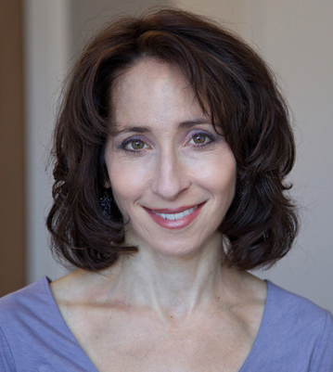
Cyclic OBesity/WEight-Based Stigma
(COBWEBS) Model
Jennifer Daubenmier, UCSF
Elissa Epel, UCSF

Slide 11
Conclusions from Lab Studies of Eating, Part I
Consumption After a High-Fat Preload
Psychology of Eating
Study 1: Stigma and cortisol
Hypothesis: Experiences of weight stigma will correlate with cortisol levels
Sample: 42 women with overweight/obese BMI
Weight stigma
Events: Stigmatizing Situations Inventory (Myers & Rosen, 1999)
“Losing a job because of your size”
Perception: Modified Stigma Consciousness Scale (Pinel, 1999)
“I worry that my behaviors will be viewed as stereotypical of the overweight”
(Tomiyama et al., 2014, Health Psychology)

Slide 12
Conclusions from Lab Studies of Eating, Part I
Consumption After a High-Fat Preload
Psychology of Eating
Study 1: Measures, cont’d
Cortisol
Total daily output
Cortisol awakening response
Cortisol slope
Morning cortisol
Oxidative Stress
A measure of cumulative wear and tear on cellular level

Slide 13
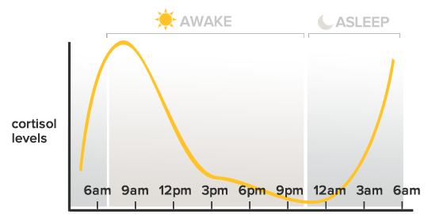
awakening response
Total daily output
Slope

Slide 14
Conclusions from Lab Studies of Eating, Part I
Consumption After a High-Fat Preload
Psychology of Eating
Study 1: Results
Experiencing events + stigma consciousness significantly related to:
Cortisol awakening response (β = 0.38, p < .05)
Morning cortisol (β = 0.39, p < .05)
Oxidative Stress (β = 0.33, p < .05)
Controls for BMI
(Tomiyama et al., 2014, Health Psychology)

Slide 15
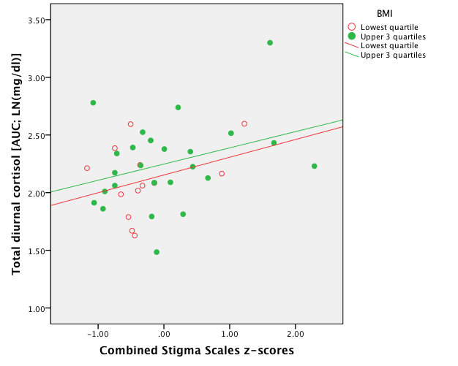
It’s not about your actual BMI, it’s how you perceive it
(Tomiyama et al., 2014, Health Psychology)

Slide 16
Obesity/Weight-Based Stigma
Stress
1. Increased Cortisol
2. Increased Eating
Weight Gain
Study 1: Stigma correlated with cortisol

Slide 17
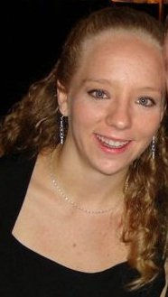
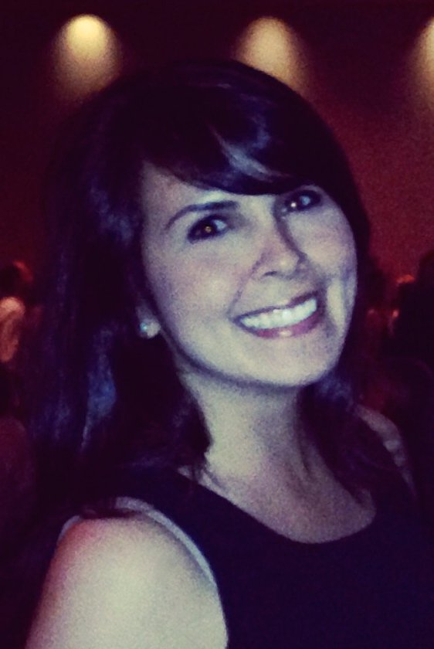
Conclusions from Lab Studies of Eating, Part 2
Consumption After a High-Fat Preload
Psychology of Eating
Study 2: Stigma experiment
Mary Himmelstein
Angela Incollingo Rodriguez
(neé Belsky)

Slide 18
Conclusions from Lab Studies of Eating, Part I
Consumption After a High-Fat Preload
Psychology of Eating
Study 2: “Psychology of Shopping”
Hypothesis: Experiencing weight stigma will cause increases in cortisol levels
Sample: 110 undergraduate women
Women who perceive self as:
Heavy
Thin
Randomized to one of two conditions:
Weight stigma
Control
(Himmelstein, Incollingo Belsky, Tomiyama, 2014, Obesity)

Slide 19
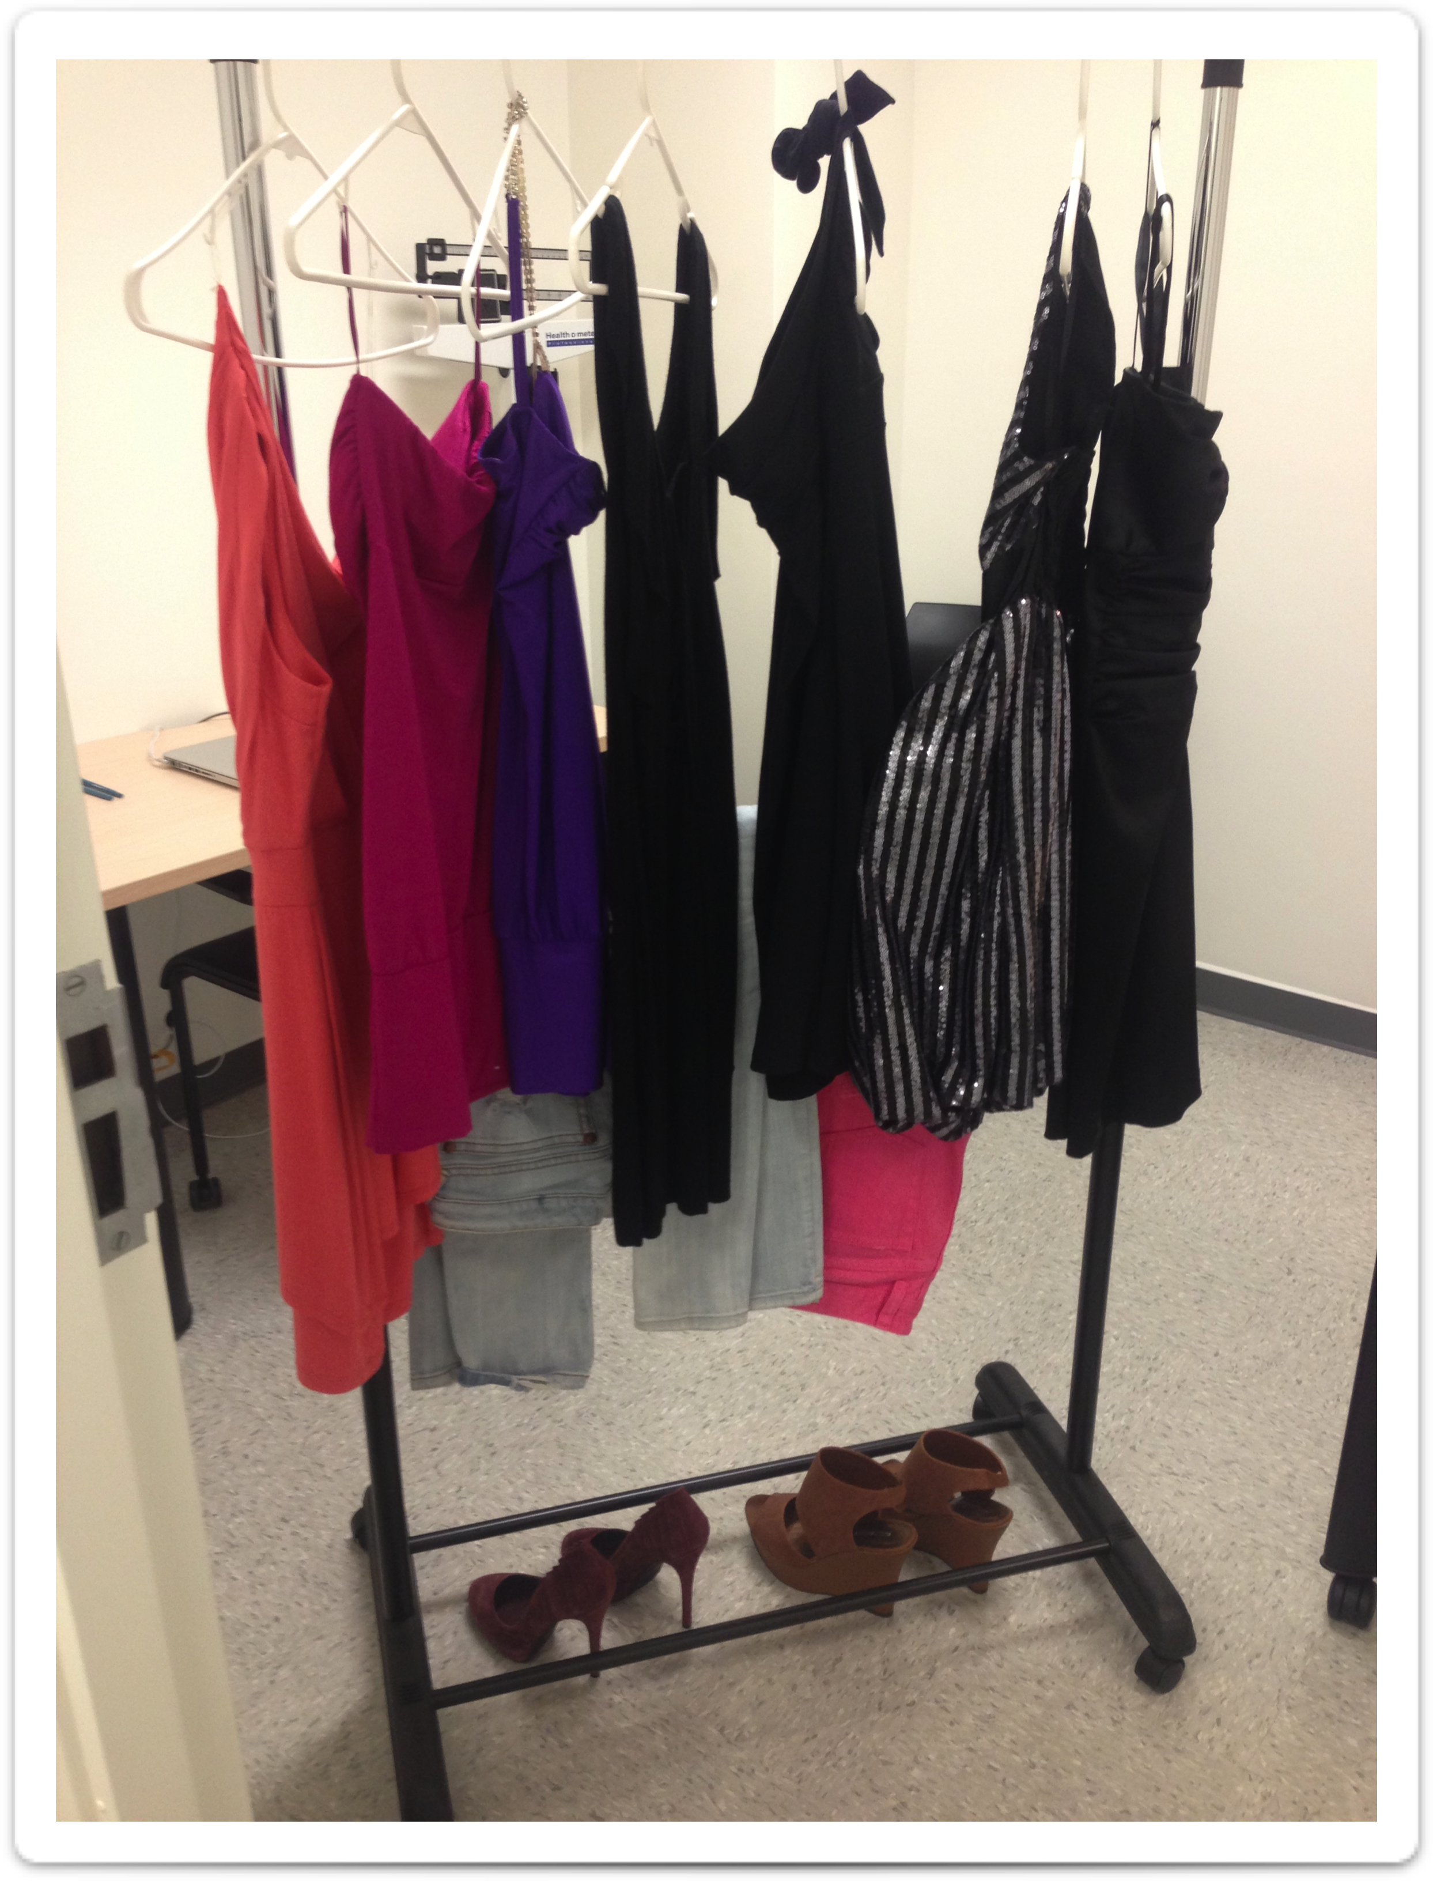
Conclusions from Lab Studies of Eating, Part I
Consumption After a High-Fat Preload
Psychology of Eating
Study 2: “Shopping room”

Slide 20
Conclusions from Lab Studies of Eating, Part I
Consumption After a High-Fat Preload
Psychology of Eating
Study 2: “Psychology of Shopping”
Weighed
Sit in waiting room with a very thin confederate
…who is accepted into the shopping activity
(Himmelstein, Incollingo Belsky, Tomiyama, 2014, Obesity)

Slide 21
Conclusions from Lab Studies of Eating, Part I
Consumption After a High-Fat Preload
Psychology of Eating
Study 2: Manipulation
“Unfortunately your shape and size just aren’t ideal for this style of clothing and we really do want everyone to have fun and feel good. Plus, we want to return the clothing to the designer in good condition.”

Slide 22
Conclusions from Lab Studies of Eating, Part I
Consumption After a High-Fat Preload
Psychology of Eating
Study 2: Procedures cont’d
Control Condition: Participants are excluded from the group shopping activity because “the study is full.”
(Himmelstein, Incollingo Belsky, Tomiyama, 2014, Obesity)

Slide 23
Conclusions from Lab Studies of Eating, Part I
Consumption After a High-Fat Preload
Psychology of Eating
Study 2: Outcomes
Salivary Cortisol: Collected pre-manipulation and 30 minutes after stigmatization
(Himmelstein, Incollingo Belsky, Tomiyama, 2014, Obesity)

Slide 24
Conclusions from Lab Studies of Eating, Part I
Consumption After a High-Fat Preload
Psychology of Eating
Study 2: Results
Hypothesis: Experiencing weight stigma will cause increases in cortisol levels
Especially for those who think they’re heavy

Slide 25
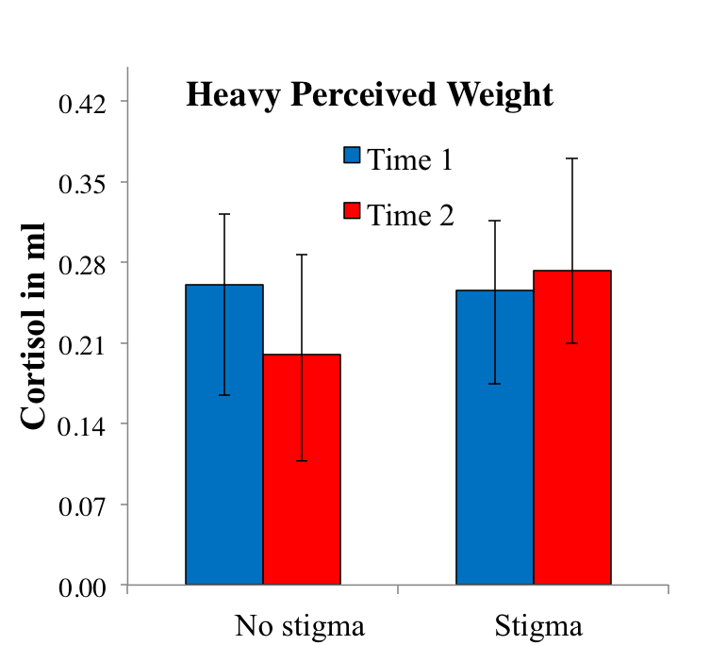
Conclusions from Lab Studies of Eating, Part I
Consumption After a High-Fat Preload
Psychology of Eating
Study 2: Results
For those who saw themselves as heavy: Stigmatized women had higher cortisol
(Himmelstein, Incollingo Belsky, Tomiyama, 2014, Obesity)

Slide 27
Obesity/Weight-Based Stigma
Stress
1. Increased Cortisol
2. Increased Eating
Weight Gain
Study 1: Stigma correlated with cortisol
Study 2: Stigma causes cortisol secretion

Slide 28
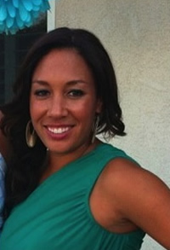
Conclusions from Lab Studies of Eating, Part 2
Consumption After a High-Fat Preload
Psychology of Eating
Study 3: Weight stigma and eating
Courtney Heldreth
Angela (again)

Slide 29
Conclusions from Lab Studies of Eating, Part I
Consumption After a High-Fat Preload
Psychology of Eating
Study 3: Methods
Hypothesis: “Putting on” weight stigma will cause increases in eating
Sample: 109 undergraduates (23.9% men)
Randomized to one of two conditions:
Fat Suit
Control
(Heldreth, Incollingo Rodriguez, & Tomiyama, 2018, Obesity)

Slide 30
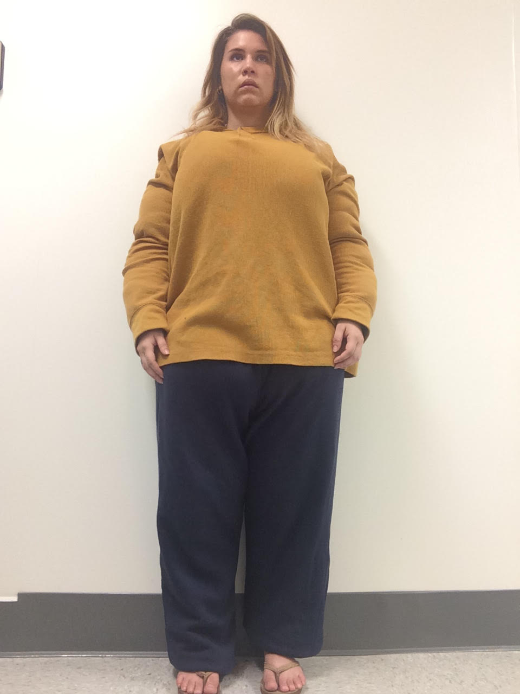

Slide 31
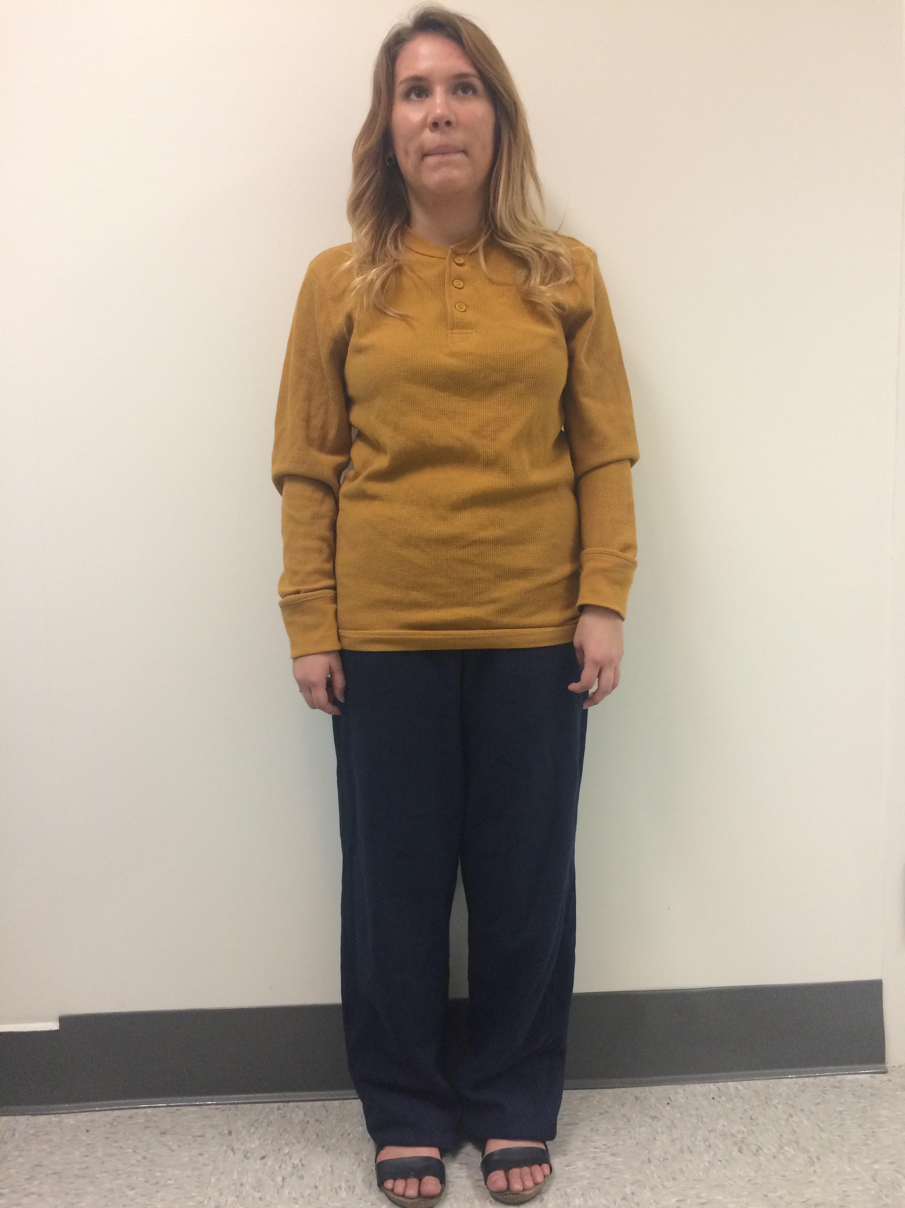

Slide 32
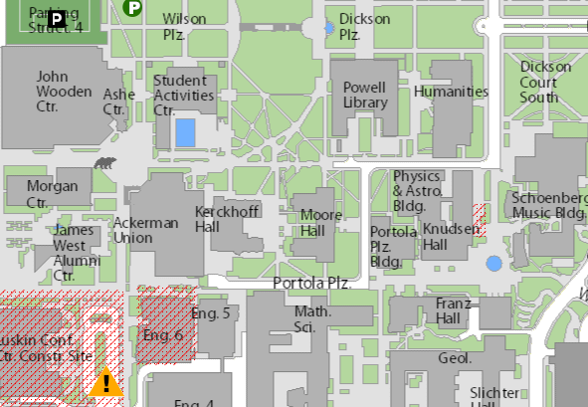

Slide 33
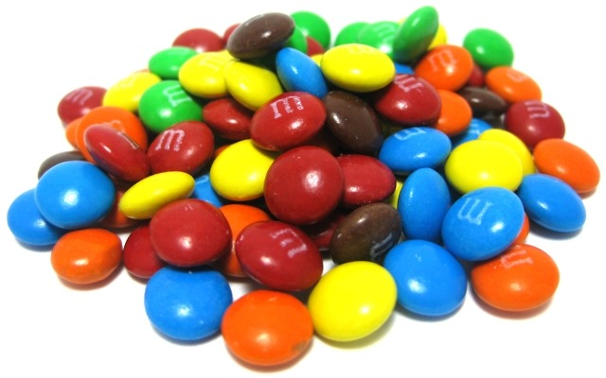
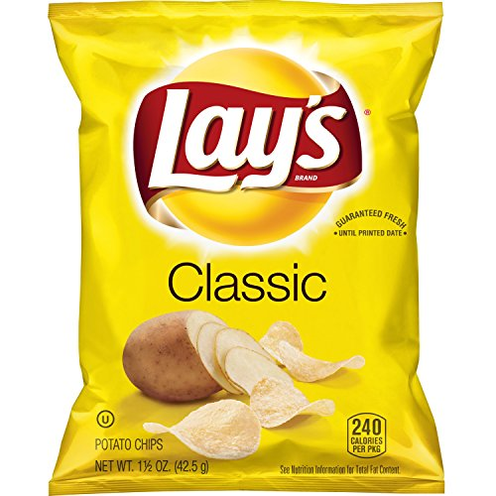
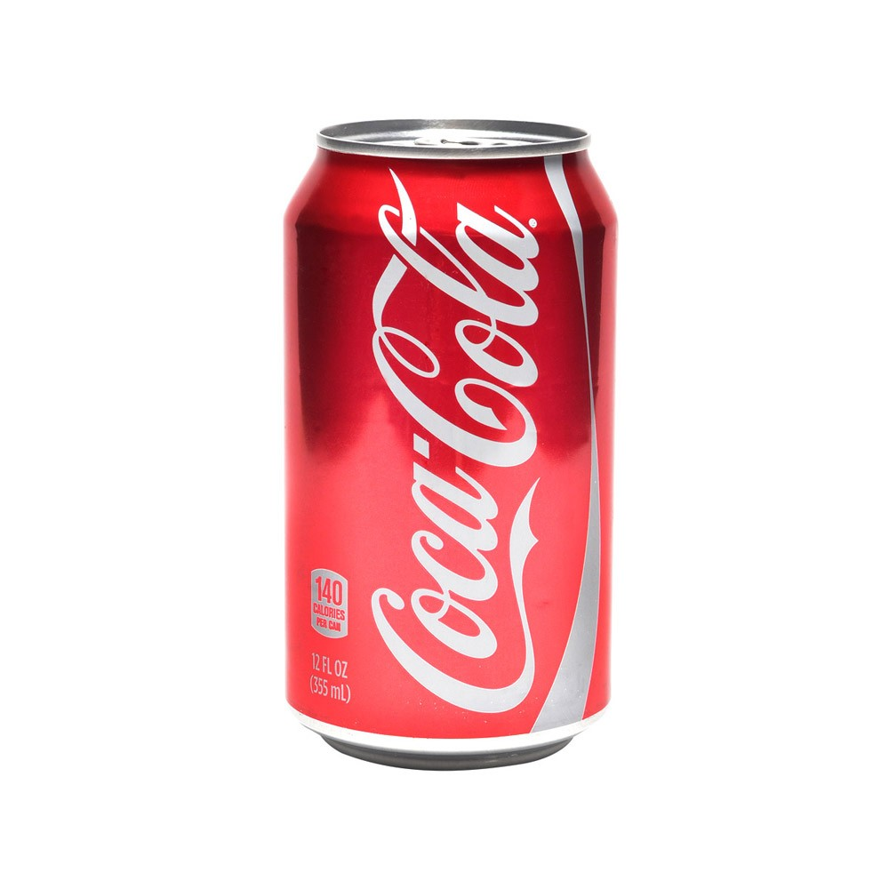
Conclusions from Lab Studies of Eating, Part I
Consumption After a High-Fat Preload
Psychology of Eating
Study 3: Outcome measures
Psychological: Anger, depression, anxiety, rejection, self-esteem, antifat attitudes
Behavioral: M&Ms, potato chips, Coca-Cola consumption
(Heldreth, Incollingo Rodriguez, & Tomiyama, 2018, Obesity)

Slide 34
Conclusions from Lab Studies of Eating, Part I
Consumption After a High-Fat Preload
Psychology of Eating
Study 3: Outcome measures
Psychological: Anger, depression, anxiety, rejection, self-esteem, antifat attitudes
Behavioral: M&Ms, potato chips, Coca-Cola consumption
(Heldreth, Incollingo Rodriguez, & Tomiyama, 2018, Obesity)

Slide 35
Obesity/Weight-Based Stigma
Stress
1. Increased Cortisol
2. Increased Eating
Weight Gain
Study 1: Stigma correlated with cortisol
Study 2: Stigma causes cortisol secretion
Study 3: Stigma causes unhealthy eating

Slide 36
Obesity/Weight-Based Stigma
Stress
1. Increased Cortisol
2. Increased Eating
Weight Gain
Study 1: Stigma correlated with cortisol
Study 2: Stigma causes cortisol secretion
Study 3: Stigma causes unhealthy eating

Slide 37
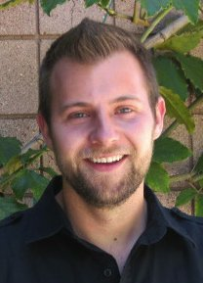
Conclusions from Lab Studies of Eating, Part 2
Consumption After a High-Fat Preload
Psychology of Eating
Study 4: Weight stigma & weight gain
Jeffrey Hunger, Miami University

Slide 38
NHLBI Growth and Health Study
1987
1997
2017-2018
40
Follow-up
(ongoing)
Age
10
11
12
13
14
15
16
17
18
19
Participants:
...from 3 sites
1213 black
1166 white
2379 girls total
Richmond, CA
Cincinnati, OH
Washington, DC

Slide 39
Conclusions from Lab Studies of Eating, Part I
Consumption After a High-Fat Preload
Psychology of Eating
Study 4: Stigma and weight
Have any of these people told you you’re too fat?
Father
Mother
Sister
Brother
Best girlfriend
Boy you like best
Teacher
(Hunger & Tomiyama, 2014, JAMA Pediatrics)

Slide 40
Conclusions from Lab Studies of Eating, Part I
Consumption After a High-Fat Preload
Psychology of Eating
Study 3: Results
Using growth curve modeling or regression, using continuous outcomes or categorical…
Controlling for all likely covariates including self esteem and body image…
(Hunger & Tomiyama, 2014, JAMA Pediatrics)

Slide 41
Conclusions from Lab Studies of Eating, Part I
Consumption After a High-Fat Preload
Psychology of Eating
Study 4: Results
Girls who experienced weight stigma were 66% more likely to have obesity by age 19, whether they were thin or heavy to begin with
For every additional…
Family member: 0.54 BMI points higher
Others: 0.21 BMI points higher
(Hunger & Tomiyama, 2014, JAMA Pediatrics)

Slide 43
Obesity/Weight-Based Stigma
Stress
1. Increased Cortisol
2. Increased Eating
Weight Gain
Study 4: Stigma longitudinally predicts weight gain
Study 1: Stigma correlated with cortisol
Study 2: Stigma causes cortisol secretion
Study 3: Stigma causes unhealthy eating
Ongoing Study: Stigma, stress, eating, and cortisol in daily life

Slide 44
Conclusions from Lab Studies of Eating, Part I
Consumption After a High-Fat Preload
Psychology of Eating
tinyurl.com/uclatextingstudy
tinyurl.com/uclatextingstudy
NSF CAREER: BCS1454735

Slide 45
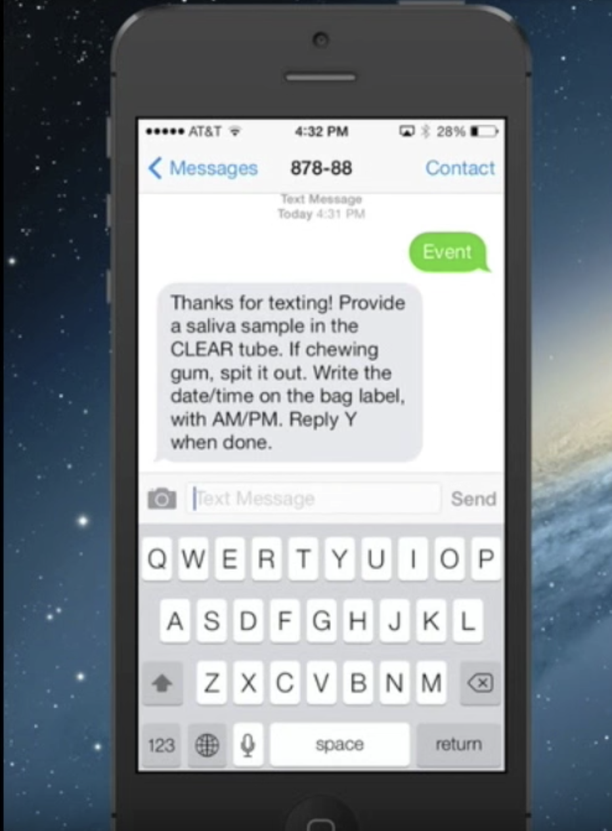
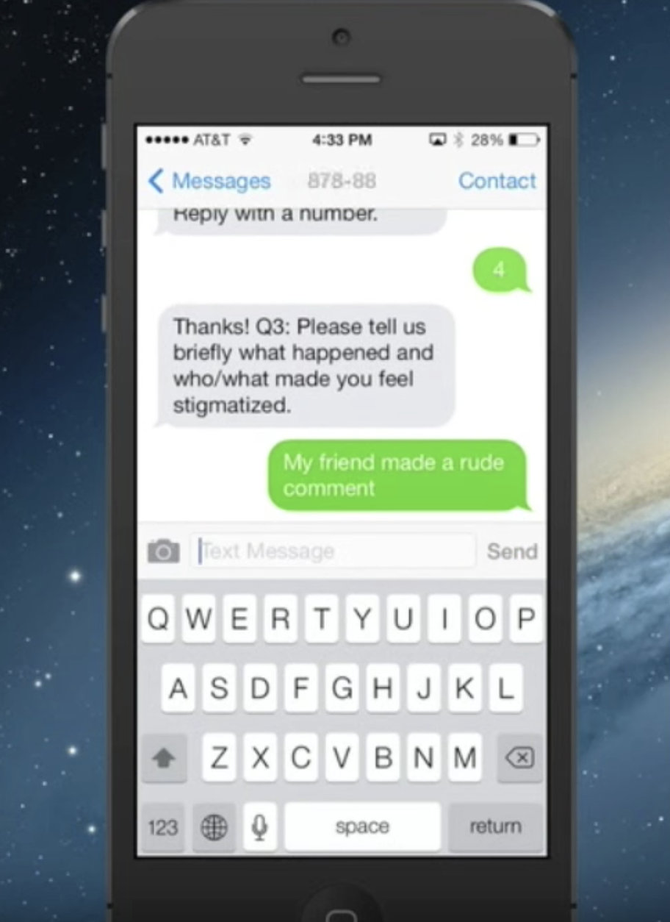
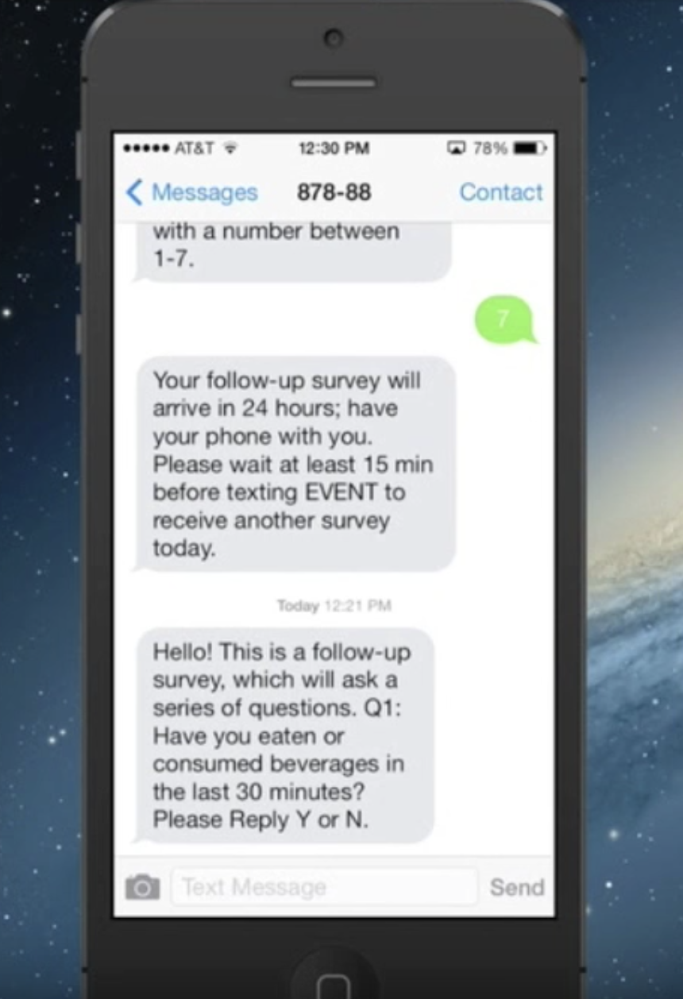

Slide 46
Conclusions from Lab Studies of Eating, Part I
Consumption After a High-Fat Preload
Psychology of Eating
Preliminary results
“I went in the store to try on clothes and the sales person told me that they didn't have anything in my size.”
“I was at the gym playing ball and one of the other guys said I've got the fat guy.”
“I was at the doctor office and of course I was told I need to lose weight, as if I'm not trying.”
NSF CAREER: BCS1454735

Slide 47
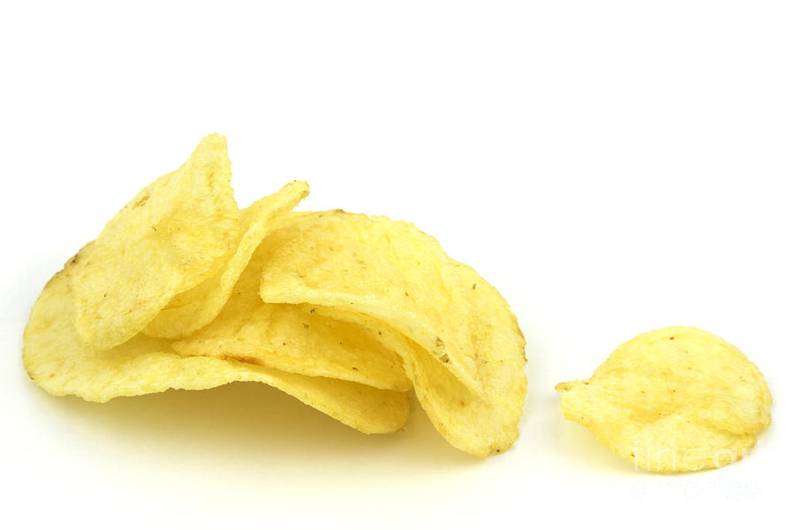
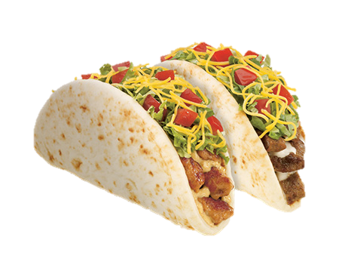
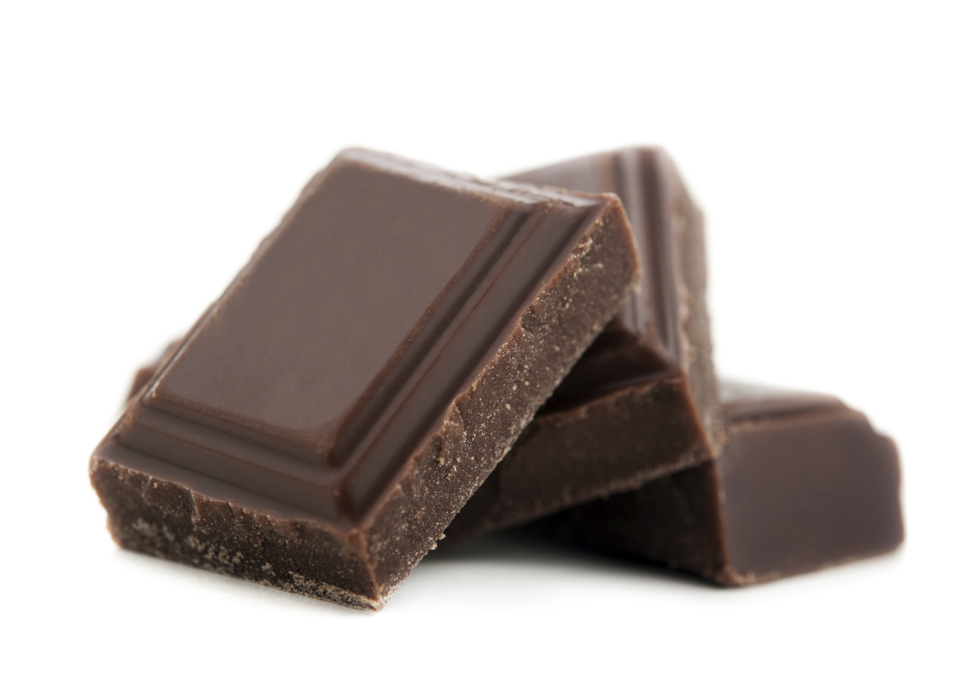
Conclusions from Lab Studies of Eating, Part I
Consumption After a High-Fat Preload
Psychology of Eating
Preliminary results
Mean food servings post-stigma: 3.21 (95% CI: 2.31,4.11)
Mean food servings 24 hrs later (control): 2.21 (95% CI: 0.54, 3.13)
NSF CAREER: BCS1454735

Slide 48
Ongoing Study: Longitudinal study to test full model
Obesity/Weight-Based Stigma
Stress
1. Increased Cortisol
2. Increased Eating
Weight Gain
Study 3: Stigma longitudinally predicts weight gain
Study 1: Stigma correlated with cortisol
Study 2: Stigma causes cortisol secretion
Ongoing Study: Stigma, stress, and cortisol in daily life

Slide 50
Conclusions from Lab Studies of Eating, Part I
Consumption After a High-Fat Preload
Psychology of Eating
Weight stigma and poor health
Mortality
In 2 nationally representative studies, weight discrimination is associated with increased mortality risk
Mental health
Weight discrimination related to 2.5x risk for mood/anxiety disorders
Intermediate health processes
Inflammation (CRP)
Metabolic processes (HbA1c), metabolic syndrome
Cellular aging (oxidative stress)
All controlling for BMI

Slide 51
Conclusions from Lab Studies of Eating, Part I
Consumption After a High-Fat Preload
Psychology of Eating
Evidence-based solutions: Part I
Are there any alternatives to dieting?
You can talk to your patients and clients about healthy behaviors without once mentioning the “W” word!
Eating more fruits and vegetables
Moving more
Sleeping better
Handling stress

Slide 52
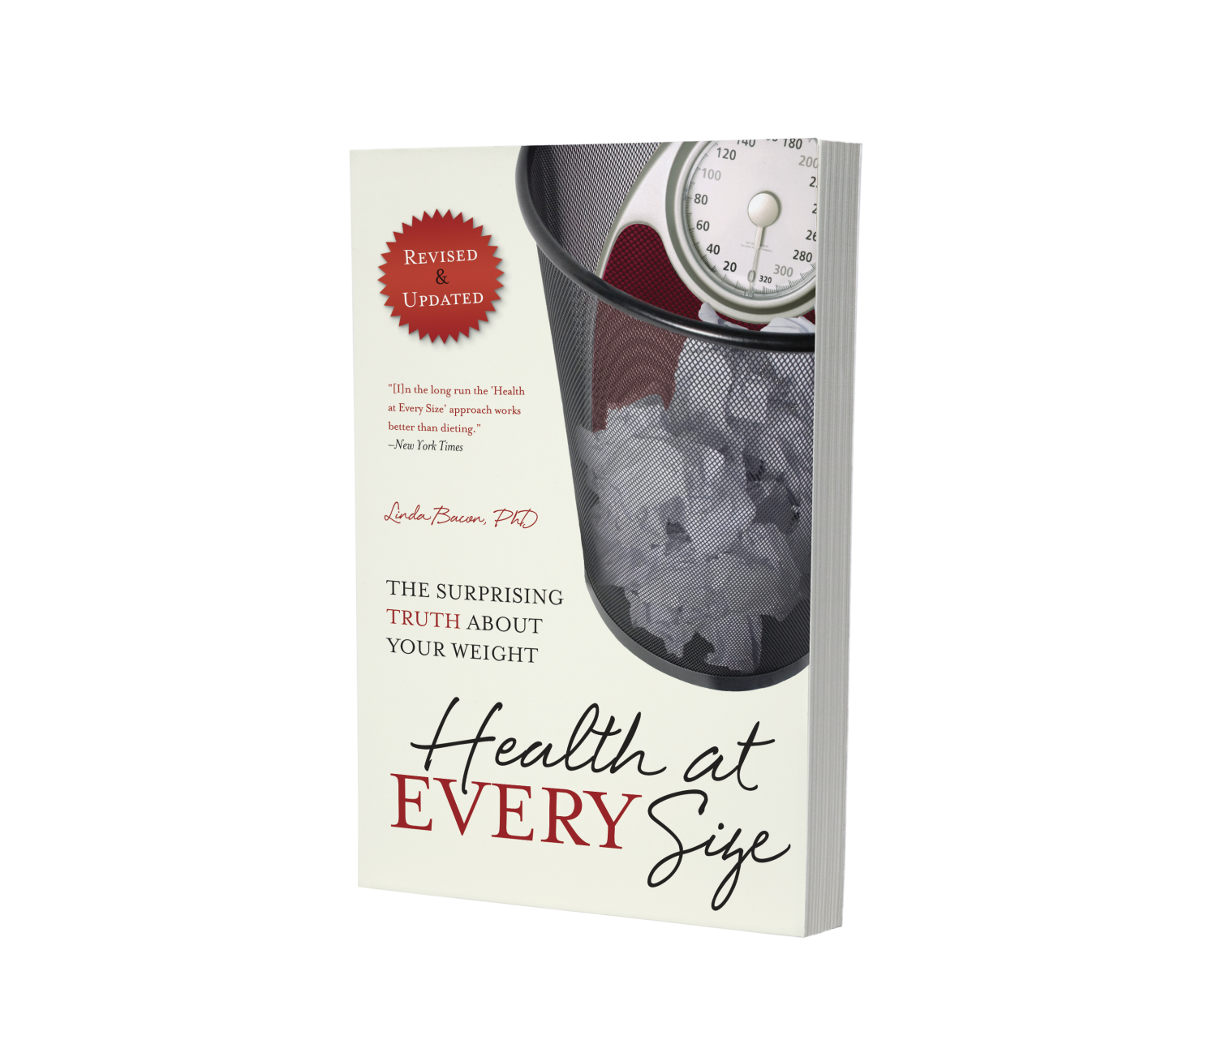
Conclusions from Lab Studies of Eating, Part I
Consumption After a High-Fat Preload
Psychology of Eating
Evidence-based solution: HAES
Are there any alternatives to dieting?
Health at Every Size
Weight-neutral
Shown in randomized controlled trials to beneficially affect:
Blood pressure
Blood lipids
Cholesterol
Binge eating
Exercise
Psychological well-being

Slide 53
Sheila Addison, 2016, https://www.slideshare.net/elusis/size-acceptance-health-at-every-size-for-mfts

Slide 54
Conclusions from Lab Studies of Eating, Part I
Consumption After a High-Fat Preload
Psychology of Eating
HAES Curriculum
Overview
haescurriculum.com

Slide 55
Conclusions from Lab Studies of Eating, Part I
Consumption After a High-Fat Preload
Psychology of Eating
Evidence-based solutions: Part II
Focus: Reducing anti-fat attitudes
Not: Coping interventions, body image interventions

Slide 56
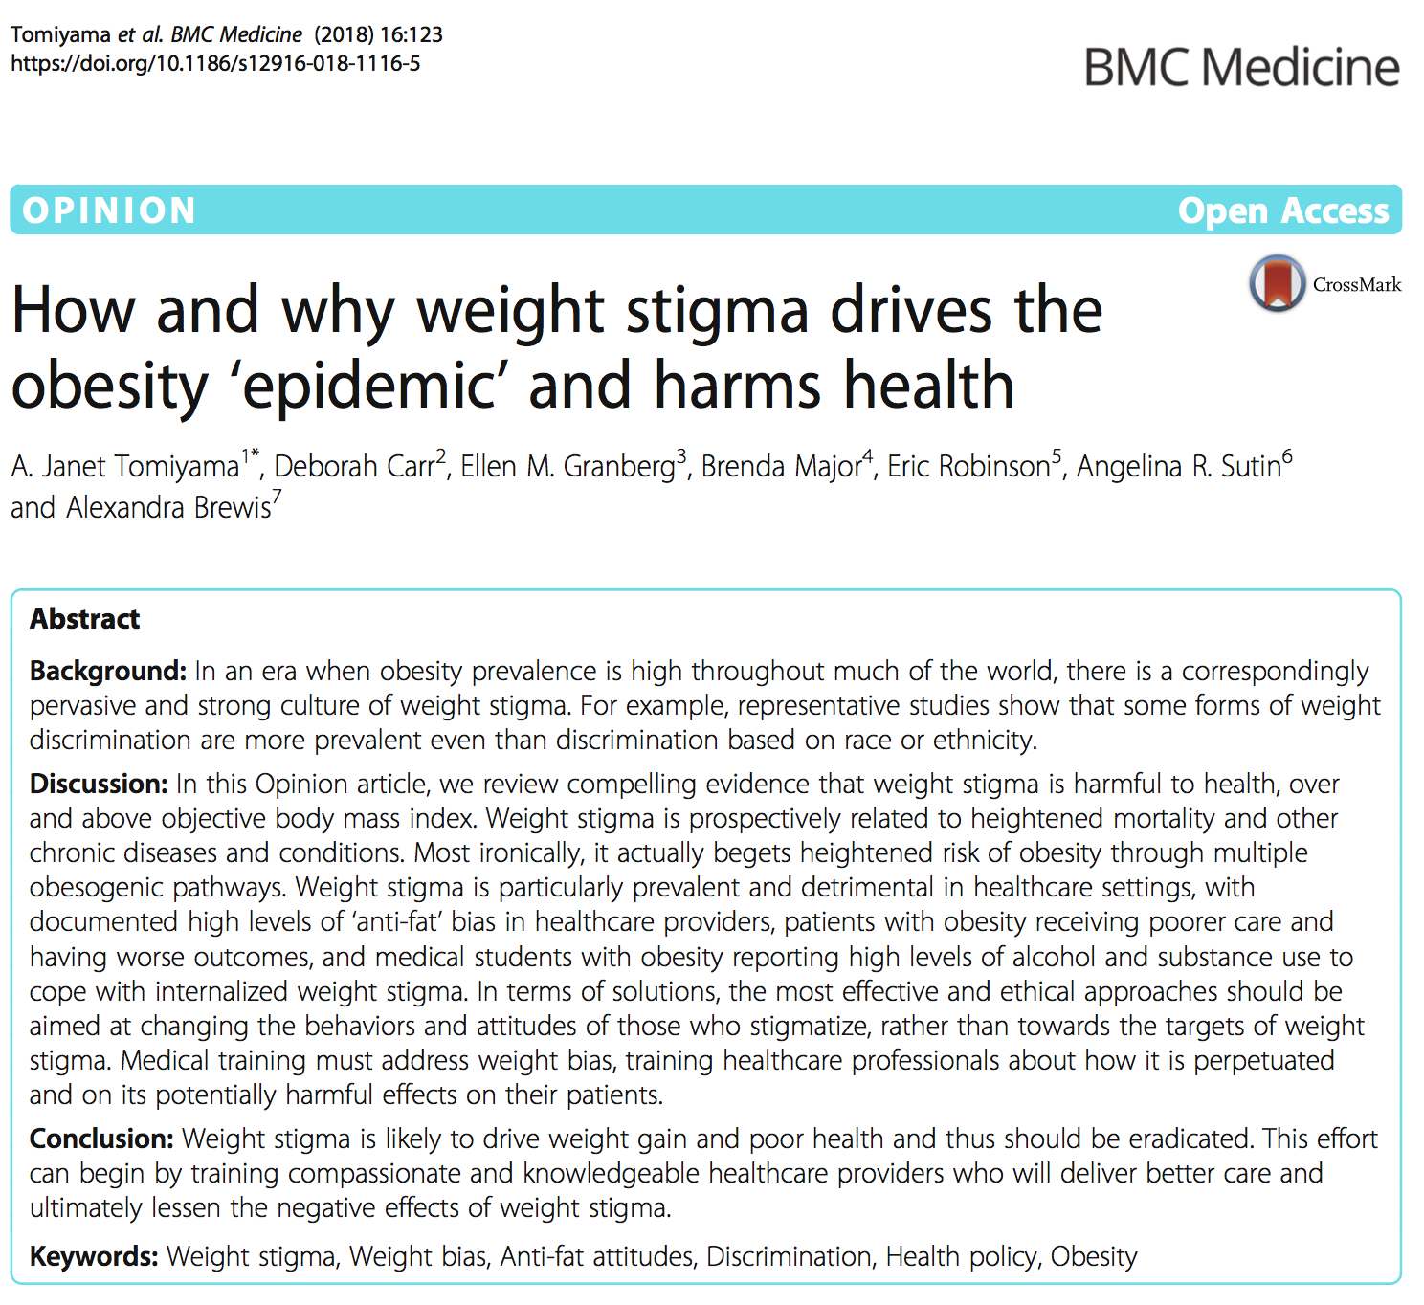
Conclusions from Lab Studies of Eating, Part I
Consumption After a High-Fat Preload
Psychology of Eating
Why this matters for providers

Slide 57
Conclusions from Lab Studies of Eating, Part I
Consumption After a High-Fat Preload
Psychology of Eating
Anti-fat bias in healthcare providers
On average, pro-thin, anti-fat attitudes among healthcare providers
Even in those specializing in obesity medicine
“Fat people are worthless”
Patients get the message
Patients with obesity delay seeking healthcare because they fear being stigmatized
Weight loss is hindered to the extent that patients perceive their provider to be anti-fat
See Tomiyama et al., 2018, BMC Medicine

Slide 58
Conclusions from Lab Studies of Eating, Part I
Consumption After a High-Fat Preload
Psychology of Eating
Medical professionals are not immune
Medical students who internalize anti-fat attitudes
Have higher depression symptoms
Report greater alcohol abuse
And substance abuse
See Tomiyama et al., 2018, BMC Medicine

Slide 59
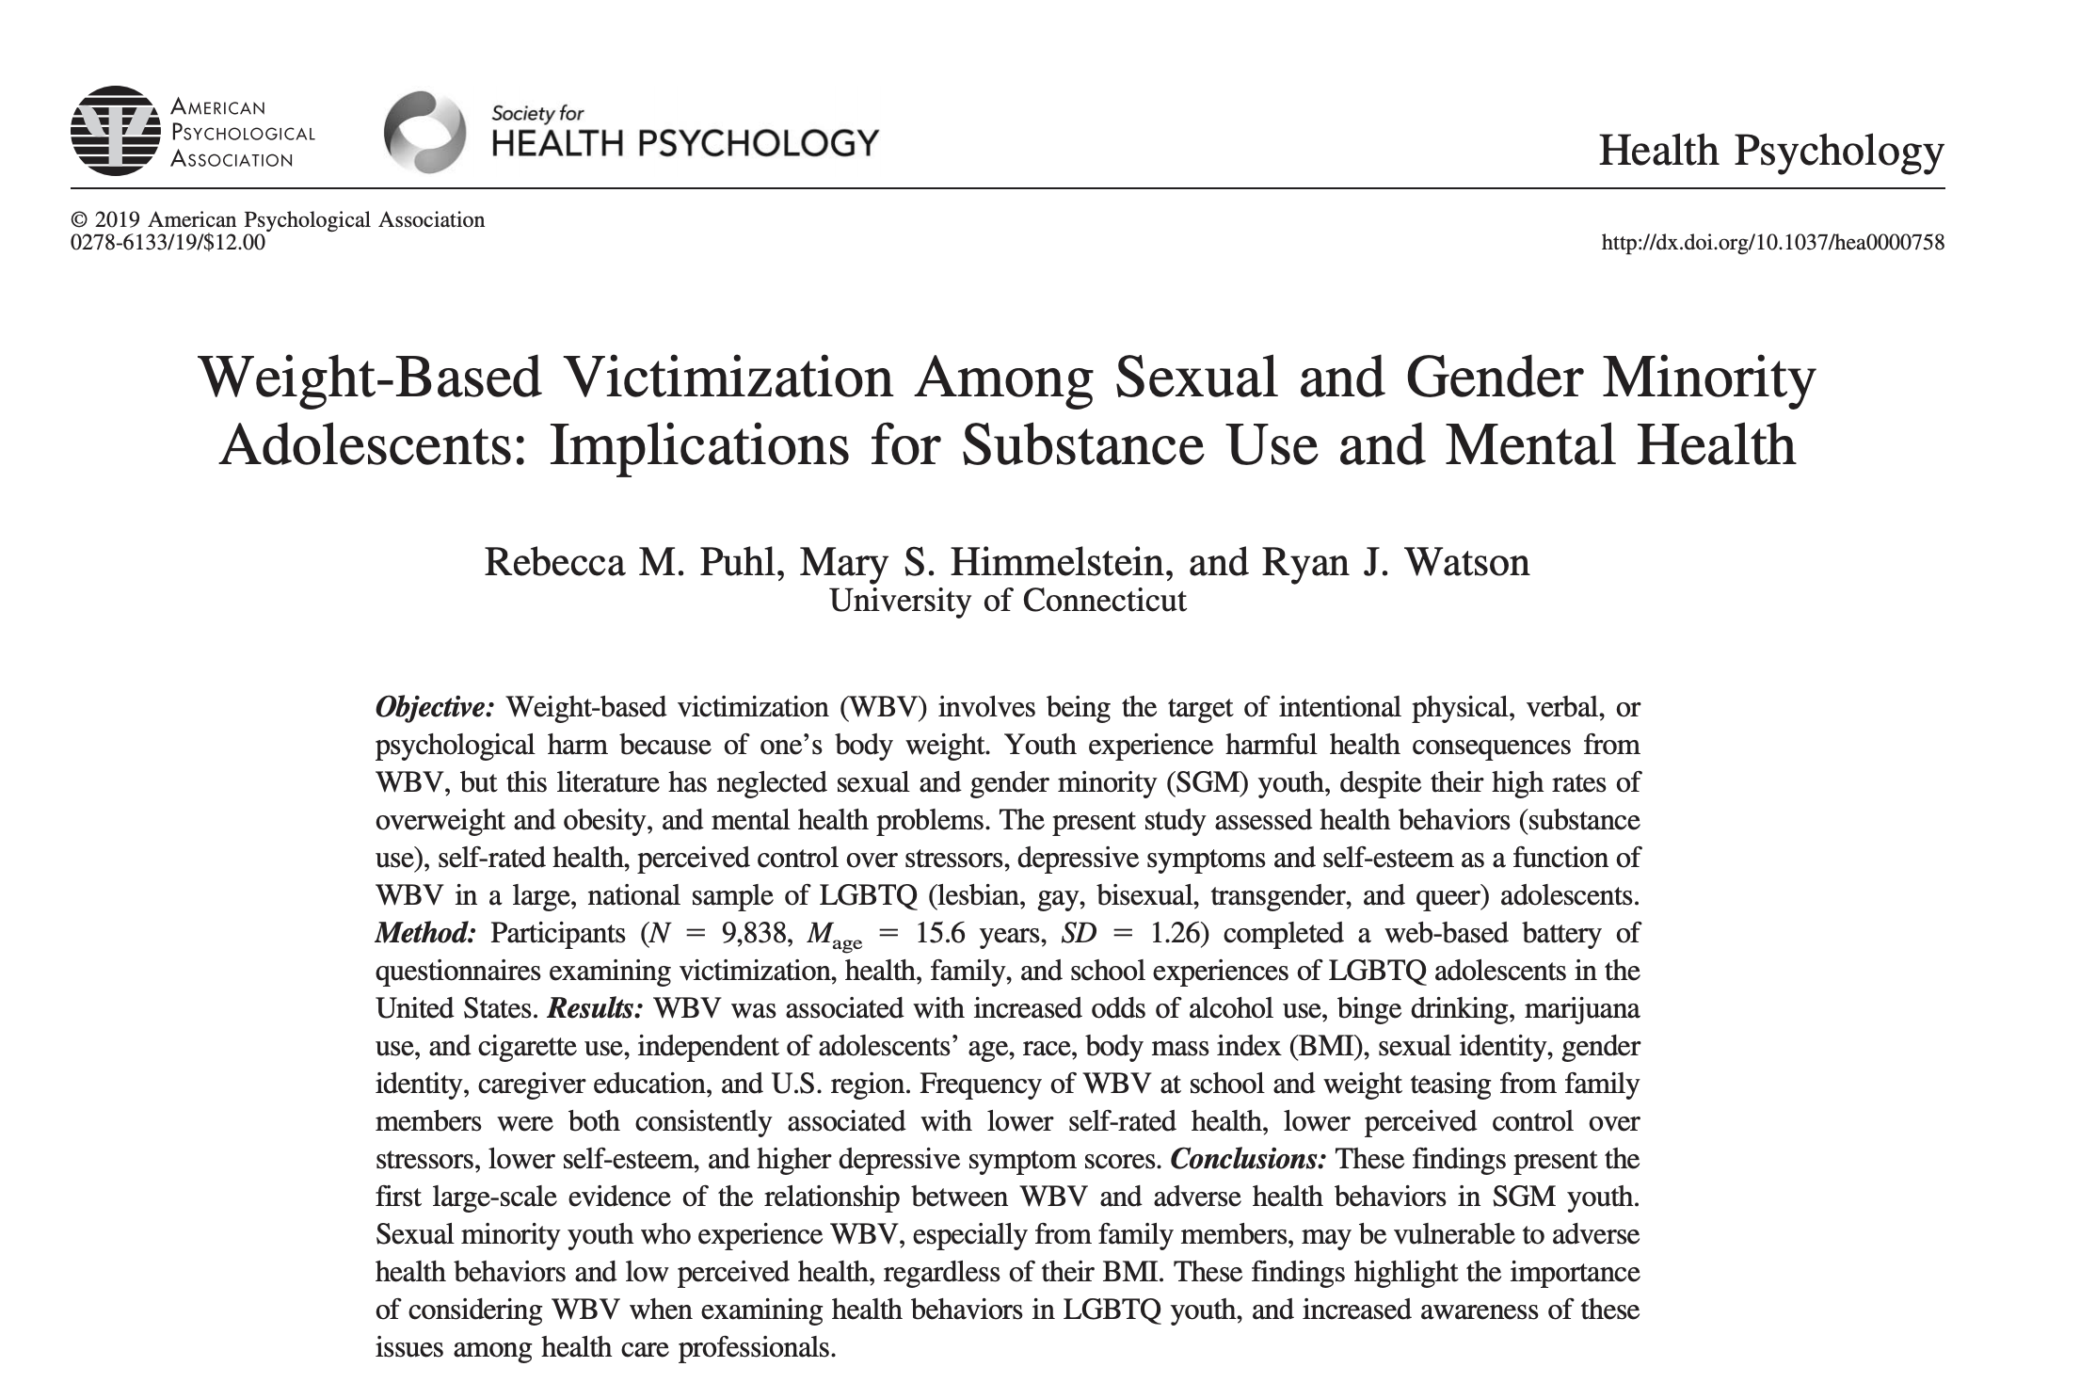
Conclusions from Lab Studies of Eating, Part I
Consumption After a High-Fat Preload
Psychology of Eating
Vulnerable populations at most risk

Slide 60
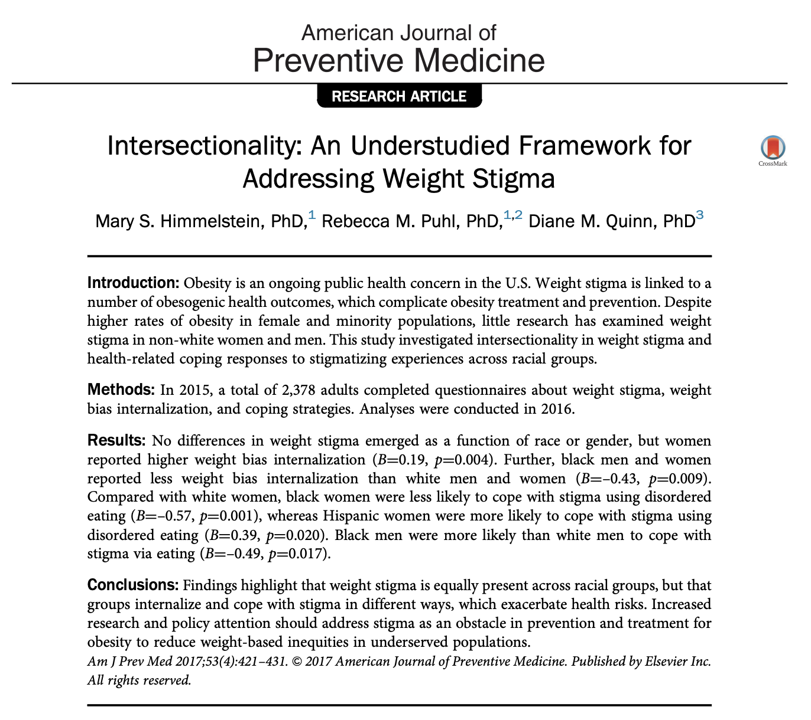
Conclusions from Lab Studies of Eating, Part I
Consumption After a High-Fat Preload
Psychology of Eating
Vulnerable populations at most risk

Slide 62
Conclusions from Lab Studies of Eating, Part I
Consumption After a High-Fat Preload
Psychology of Eating
Intervention types
Controllability interventions
Examples: Medical, genetic explanations for obesity
Empathy/acceptance interventions
Example: Videos of first-hand accounts of discrimination
Social norms
Example: (False) feedback regarding others’ beliefs
(Daníelsdóttir, O’Brien, Ciao, 2010, Obesity Facts)

Slide 63
Conclusions from Lab Studies of Eating, Part I
Consumption After a High-Fat Preload
Psychology of Eating
Meta-analysis
Overall effect: d = -.33 (small/medium size)
But, credibility interval = -0.72 to 0.06 indicating no reliable effect
And no differences between:
Type of intervention
Study population
(Lee, Ata, & Brannick, 2010, Body Image)

Slide 64
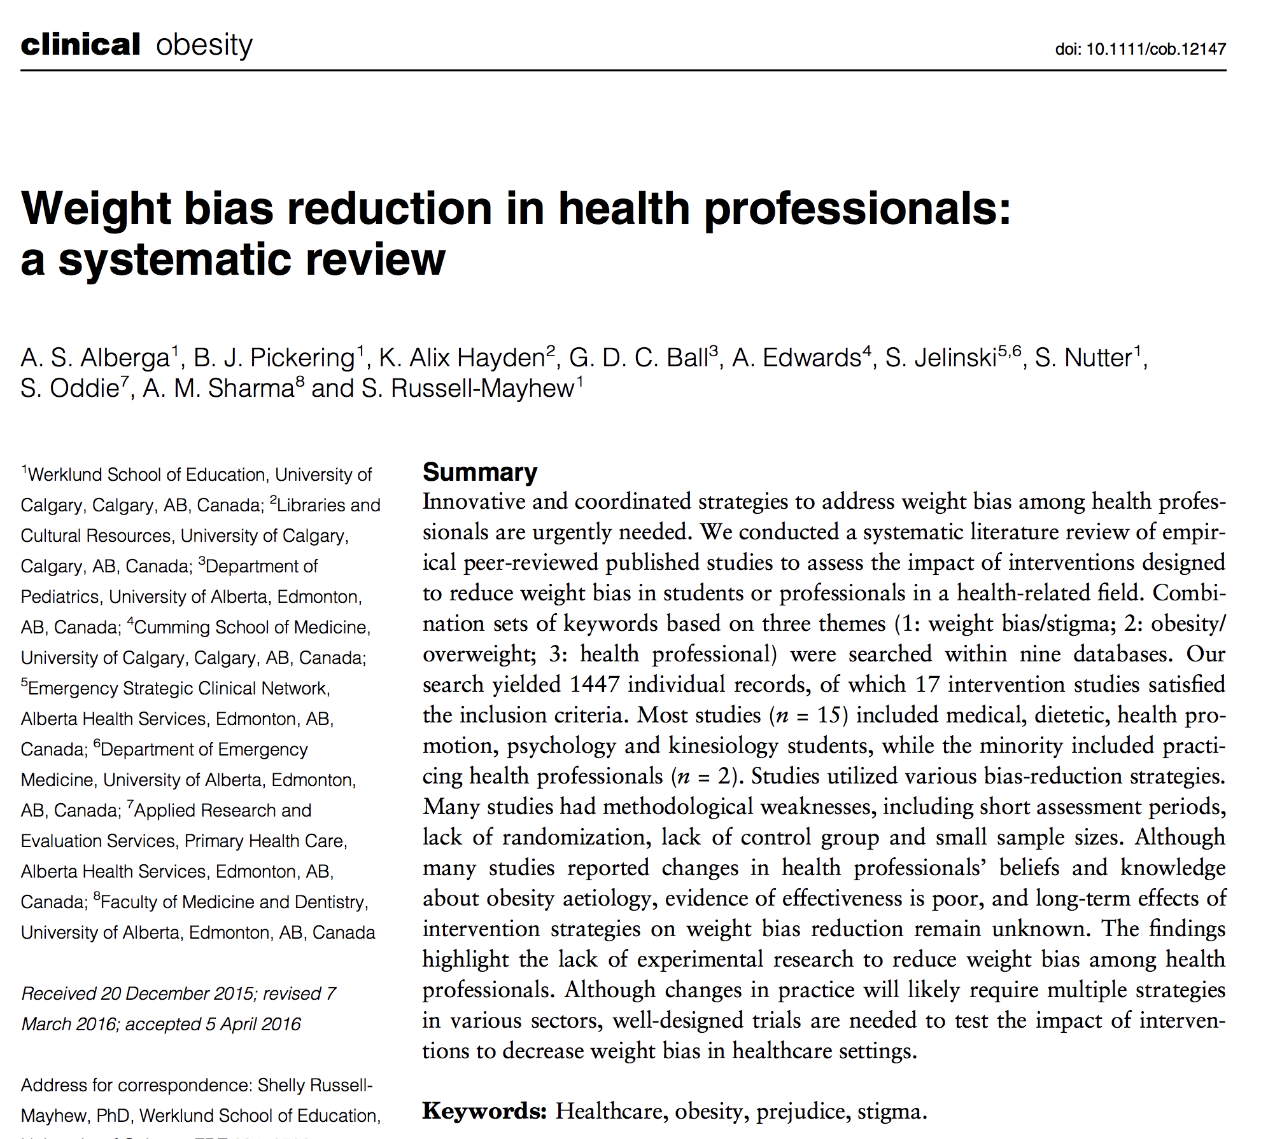

Slide 65
Conclusions from Lab Studies of Eating, Part I
Consumption After a High-Fat Preload
Psychology of Eating
Intervention types
Controllability interventions
Examples: Medical, genetic explanations for obesity
Empathy/acceptance interventions
Example: Videos of first-hand accounts of discrimination
Social norms
Example: (False) feedback regarding others’ beliefs
Weight stigma awareness
Example: uconnruddcenter.org/weight-bias-stigma-videos-exposing-weight-bias

Slide 68
Conclusions from Lab Studies of Eating, Part I
Consumption After a High-Fat Preload
Psychology of Eating
Brainstorming & Discussion
5 minutes: Design an intervention to decrease weight stigma.
Your target could be healthcare providers, general public, or policymakers.
What “ingredients” would you choose? Specify 2-3 components.
Be prepared to report out to the larger group.

Slide 69
Conclusions from Lab Studies of Eating, Part I
Consumption After a High-Fat Preload
Psychology of Eating
Intervening with healthcare providers

Slide 70
Conclusions from Lab Studies of Eating, Part I
Consumption After a High-Fat Preload
Psychology of Eating
Objectives
Self-awareness of one’s intrinsic bias
Knowledge on the uncontrollability of obesity
Increasing empathy for individuals with obesity
Shifting social norms regarding the acceptability of weight bias

Slide 71
Conclusions from Lab Studies of Eating, Part I
Consumption After a High-Fat Preload
Psychology of Eating
General approach
Maximize buy-in
Title: “Treating Obesity with Dignity and Evidence-Based Care”
Respected internal speakers
Email communication from Medical Director / Chief of Staff

Slide 72
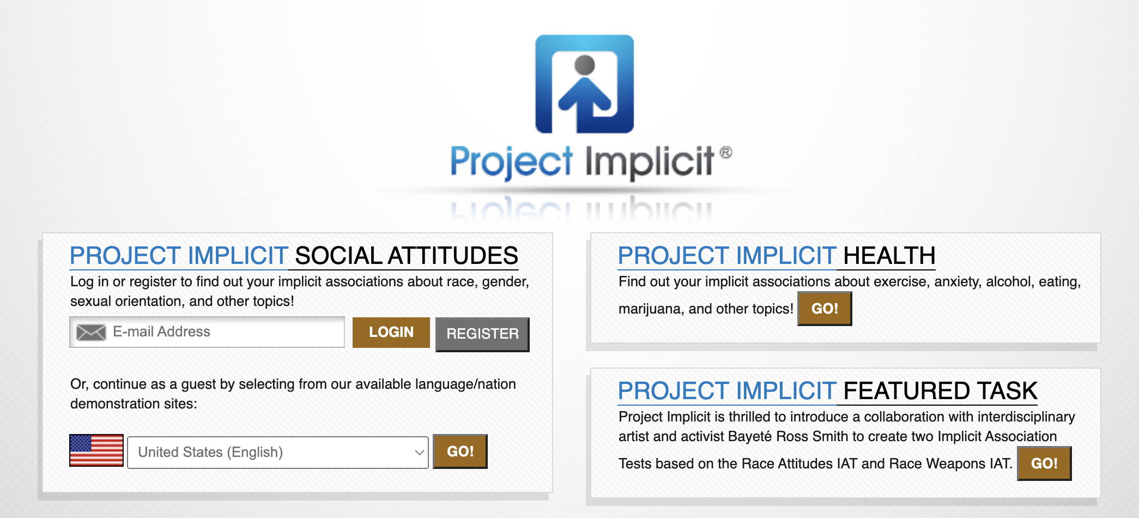
Conclusions from Lab Studies of Eating, Part I
Consumption After a High-Fat Preload
Psychology of Eating
Objectives
Increase self-awareness of one’s intrinsic bias

Slide 73
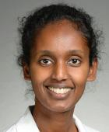
Conclusions from Lab Studies of Eating, Part I
Consumption After a High-Fat Preload
Psychology of Eating
Objectives
2. Provide knowledge on the uncontrollability of obesity
$√−$Amanda Velazquez, MD, DABOM
Bariatric Medicine / Internal Medicine
WLA Kaiser Permanente
$√−$Ambie Yesus, MD,MSHS, DABOM
Physician in Charge, Bariatric Medicine
WLA Kaiser Permanente
$√−$Karen Coleman, PhD, MS
Research Scientist III
Department of Research and Evaluation
Kaiser Permanente Southern California
$√−$Helmuth Billy, MD, FASMBS
Medical Director, Bariatric Surgery
Ventura Advanced Surgical Associates
Community Memorial Hospital,
Venutra, CA

Slide 74
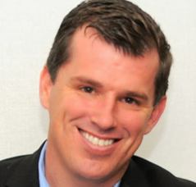
Conclusions from Lab Studies of Eating, Part I
Consumption After a High-Fat Preload
Psychology of Eating
Objectives
3. Increase empathy for individuals with obesity
$√−$Joe Nadglowski,
President and CEO of
Obesity Action Coalition (OAC)
Speaker, Author and Patient Advocate
$√−$Patty Nece, JD
Chair member of Obesity Action Coalition (OAC)
Patient Advocate of Obesity Action Coalition
$√$– Robert Kushner, MD, DABOM
Professor of Medicine
Medical Director, Center for Lifestyle Medicine
Northwestern University
Past President of the Obesity Society
Founder of the American Board of Obesity Medicine (ABOM)

Slide 75
Conclusions from Lab Studies of Eating, Part I
Consumption After a High-Fat Preload
Psychology of Eating
Objectives
4. Shift social norms regarding the acceptability of weight bias

Slide 76
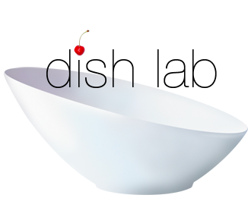
Conclusions from Lab Studies of Eating, Part I
Consumption After a High-Fat Preload
Psychology of Eating
Thank you
tomiyama@psych.ucla.edu
www.dishlab.org

